Slide 1



Unlocking the Future of Ethics: Leveraging Synthetic Data to Improve Higher Education Dropout Prediction with Machine Learning
PAPER ID: 2025051026
Muhammad Amin Nadim, Emanuele Marsico
Raffaele Di Fuccio
Pegaso Telematic University & University of Foggia ,Italy

Slide 2
Introduction
Higher Education Student dropout is critical global concern for academic quality, institutional sustainability, and educational equity (Rabelo et al., 2025)
Although Higher Education dropout research spans decades and modern predictive modeling still grapples with challenges such as data sparsity, privacy constraints (V. Tinto et al., 1975, Trinidad et al., 2022).
Real student data is increasingly restricted by GDPR and FERPA, limiting machine learning innovation. (AACRAO 2025).
The solution is synthetic data generation; but not just technically, theoretically and ethically guided.
CEDA (Constructivist–Ethical Data Augmentation); a proposed framework presents a human-centered, ethically aligned, theory-informed AI approach for dropout prediction.
Overall Focus of this work to integrates learning theory with responsible AI ; redefining dropout prediction as both a technical and educational challenge.
*American Association of Collegiate Registrars and Admissions Officers (AACRAO) *Family Educational Rights and Privacy Act (FERPA) in USA *General Data Protection Regulation (GDPR) in Europe

Slide 3
Why This Study is Important
Key Problems
1. High Dropout Rates: 12% in 1st year and 23% by 3rd year across OECD nations.(OECD 2022)
2. Limited Data Access: GDPR & FERPA restrict authentic learner data.
3. Algorithmic Bias: Models often amplify social or gender disparities.
4. Lack of Theoretical Depth: Most predictive models ignore motivation, self-efficacy, or context.
5. Ethical Deficit: Few frameworks ensure fairness, privacy, and transparency simultaneously.
Why It Matters:
1.Predictive models directly affect student lives and must be trustworthy, interpretable, and fair.
2.CEDA bridges the gap between pedagogy, psychology, and AI ethics.
3.It moves from black-box accuracy to transparent, theory-driven accountability.
This work demonstrates that data ethics and educational empathy can coexist with
high model accuracy.
*Organisation for Economic Co-operation and Development (OECD) *Family Educational Rights and Privacy Act (FERPA) in USA *General Data Protection Regulation (GDPR) in Europe

Slide 4
Research Purpose and Objectives
Aim
To design an ethical, theory-informed, and privacy-preserving AI framework for higher education student's dropout prediction using synthetic data enriched with psychological constructs.
Objectives
1. Develop a constructivist–ethical augmentation pipeline combining Self-Determination Theory (SDT) and Constructivist Learning Theory (CLT).
2. Generate synthetic yet educationally meaningful data using CTGAN & TVAE.
3. Train interpretable ensemble models (LightGBM, RF, XGBoost).
4. Evaluate fairness, accuracy, and transparency using DPD, and SHAP.
5. Validate whether synthetic data can ethically rival real datasets.
* Demographic Parity Difference (DPD) *Conditional Tabular Generative Adversarial Networks (GANs) (CTGAN) *Tabular Variational Autoencoders (TVAE)

Slide 5
Research Questions Focused
RQ1 : Can theoretically grounded synthetic data match or exceed real data in predicting student dropout?
RQ2 : How do simulated psychological–behavioral constructs (like motivation, self-efficacy) influence model
performance and interpretability?
RQ3: Does the inclusion of synthetic data improve fairness and generalizability in machine learning models?
RQ4: Can SHAP-based interpretability validate theory-driven feature engineering and ensure conceptual
alignment between simulated and observed data?
Each RQ connects a fundamental ethical AI concern ; accuracy, transparency, fairness, and theory
alignment

Slide 6
Theoretical Foundation
Theories Integrated
To design an ethical, theory-informed, and privacy-preserving AI framework for higher education dropout prediction using synthetic data enriched with psychological constructs.
1.Constructivist Learning Theory (Vygotsky, 1978)
Learners build knowledge through social and contextual interaction.
Dropout = systemic misalignment between student and institution.
2.Self-Determination Theory (Deci & Ryan, 1985):
Motivation arises from autonomy, competence, and relatedness.
Operationalized as proxies in data (class timing, GPA, socioeconomic factors).
Innovation
Embedding theory: data itself (not post hoc interpretation)
Simulated constructs: motivation, self-efficacy, social support
CEDA turns abstract educational psychology into tangible machine learning features.

Slide 7
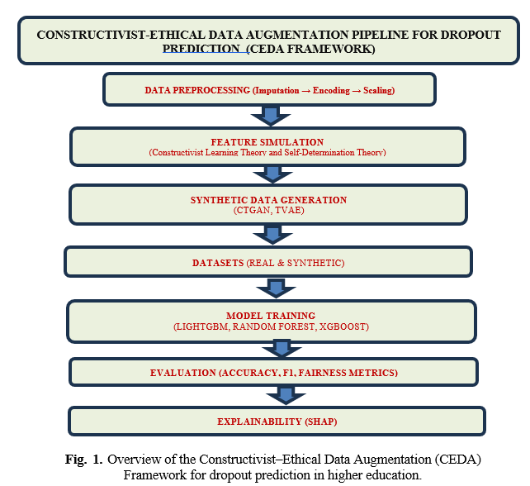
Proposed Framework Overview
Constructivist–Ethical Data Augmentation (CEDA) Framework
Data Preprocessing (Cleaning, Encoding, Scaling)
Psychological: Behavioral Feature Simulation
Synthetic Data Generation (CTGAN, TVAE).
Model Training (LightGBM, RF, XGBoost)
Fairness & Ethical Validation (DPD, SHAP)
Core Principals
Ethical Integrity: privacy, fairness, interpretability.
Pedagogical Validity: motivation & engagement simulated.
Scalability :To be tested across diverse datasets, disciplines, and the University of Telepgaso data.
Overall CEDA operationalizes ethics, theory, and AI within one integrated pipeline.
* Demographic Parity Difference (DPD) *Conditional Tabular Generative Adversarial Networks (GANs) (CTGAN) *Tabular Variational Autoencoders (TVAE)

Slide 8
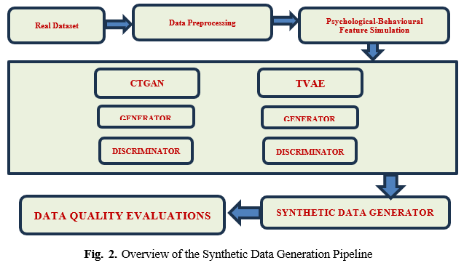
Ethical Synthetic Data Creation (CTGAN & TVAE)
Approach
CTGAN: Conditional sampling for categorical–numerical balance.
TVAE: Latent variable diversity for realistic synthetic distributions.
Validation:
KS tests for statistical fidelity
Correlation preservation
Privacy tests (real–synthetic distinguishability)
Outcome
Generated data preserves original feature dependencies.
Achieves privacy compliance with GDPR & FERPA.
Selected academic, demographic, financial, and behavioral features.
Synthetic data becomes not artificial but ethically amplified.
*Conditional Tabular Generative Adversarial Networks (GANs) (CTGAN) *Tabular Variational Autoencoders (TVAE)

Slide 9
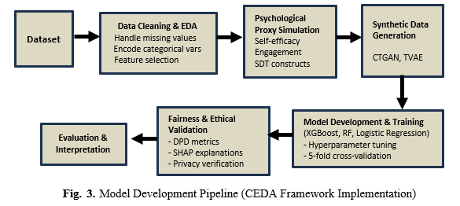
Methodological Design
Dataset
Predict Students’ Dropout and Academic Success (UCI Repository).
4,424 students, 32 variables → dropout/graduation/enrolled.
Preprocessing
Label encoding, imputation, correlation checks.
Selected academic, demographic, financial, and behavioral features.
80:20 stratified split for generalizability.
Proxy Simulation (SDT Constructs):
Self-efficacy → GPA consistency
Motivation → scholarship status
Engagement → attendance & grades
Overall, this ensures that the augmented dataset is diverse, realistic, and suitable for robust model training, while still preserving the key characteristics of the original data.

Slide 10
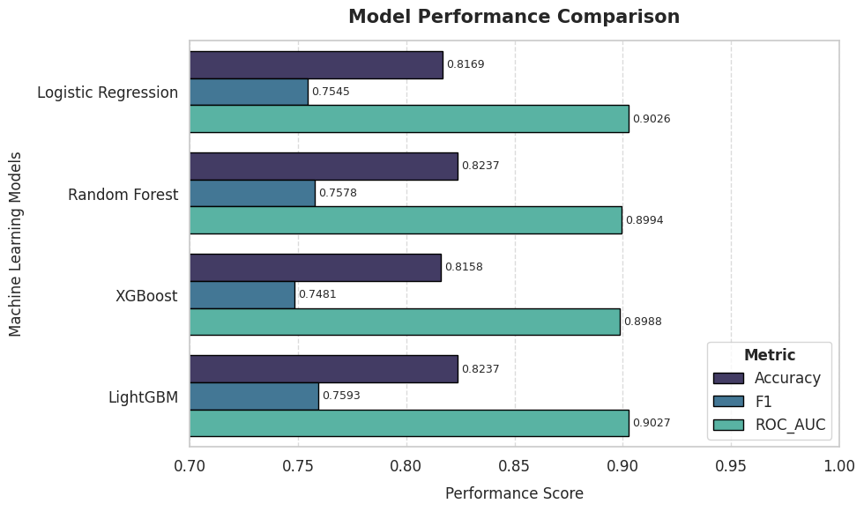
Model Training & Observations
Model | Observations | Accuracy | F1 Score | ROC-AUC
Light GBM | Best synthetic model; maintains robustness and interpretability. | 0.8237 | 0.7593 | 0.9027
XGBoost | Slightly underperforms vs. LightGBM; sensitive to synthetic variance. | 0.8158 | 0.7481 | 0.8988
Random Forest | Stable ensemble; handles synthetic feature distributions well. | 0.8237 | 0.7578 | 0.8994
Logistic Regression | Strong baseline; slight drop due to lack of real noise patterns. | 0.8169 | 0.7545 | 0.9026
Model Used
Random Forest
XGBoost
LightGBM
Evaluation Metrics:
Accuracy, F1, ROC-AUC
LightGBM achieved balance between accuracy,
fairness, and interpretability.
Fig. 4. Model Performance Comparison

Slide 11
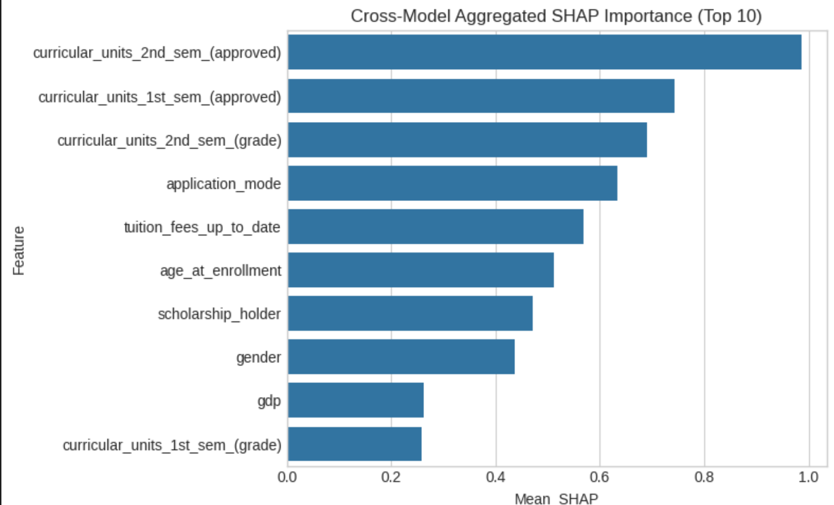
Ethical Validation of Predictions
Theories Integrated
Group fairness: DPD ≈ 0.32–0.33 (acceptable parity).
Bias mitigation: reweighing and threshold calibration.
SHAP Explainability
Top contributing features (LightGBM model):
Curricular Units (2nd sem. approved): persistence/
self-regulation.
2. Curricular Units (1st sem. approved): early adaptation.
3. Curricular Units (2nd sem. grades):self-efficacy.
The same features driving predictions mirror those
in educational psychology validating construct authenticity.
* Demographic Parity Difference (DPD

Slide 12
Major Findings and Research Contributions
Empirical Findings (Machine Learning Models Level & Synthetic Dataset)
The LightGBM classifier provided the most consistent performance (Accuracy = 0.8237, F1 = 0.7593, ROC– AUC = 0.9027), achieving only a marginal decline (ΔAUC ≈ 0.025) compared to real-data performance, thus preserving high fidelity between real and synthetic domains.
Improved fairness, transparency, and minority class recall.
Psychological feature simulation increased model interpretability.
SHAP validation confirmed theory-aligned reasoning.
Mean KS Statistic (CTGAN) shown that <0.1 means most real–synthetic feature distributions overlap well.
Mean KS Statistic (TVAE) found within fidelity threshold (<0.15) during synthetic data creation.
Correlation matrices of synthetic and real data are >94% similar.
Privacy Protection of synthetic data : Near 0.5 indistinguishable; indicates strong privacy and minimal re-identification risk
Nearest Neighbor Distance Ratio (NNDR): 0.021 Synthetic samples sufficiently distinct; no data leakage from original records.
*Area Under Curve (AUC)

Slide 13
Educational and Ethical Implications
Conceptual Impacts
Reframes dropout prediction from technical → human-centered problem.
Fuses AI ethics with learning theory.
Demonstrates privacy-preserving analytics can still be interpretable.
Institutional Impact
Enables compliant, reproducible AI without sensitive data.
Promotes responsible innovation in education.
Provides blueprint for ethical deployment of predictive models.
CEDA Framework offers an ethically grounded, pedagogically coherent roadmap for educational AI.

Slide 14
Limitations & Path Forward
Limitations
CTGAN and TVAE models require intensive GPU computation and long convergence times, especially during hyperparameter tuning and multi-round validation.
Planned Extensions
Longitudinal modeling using LSTMs/Transformers.
Expansion to constructs like resilience, belonging, digital engagement.
Causal inference methods for bias auditing.
Real-time dashboards for explainable student analytics.
Vision
From data protection to data enrichment — advancing ethical, fair, and human-centered AI.
*Conditional Tabular Generative Adversarial Networks (GANs) (CTGAN) *Tabular Variational Autoencoders (TVAE)

Slide 15
References
Rabelo, A. M., & Zárate, L. E. (2025). A model for predicting dropout of higher education students. Data Science and Management, 8(1), 72-85.
V. Tinto. Dropout from higher education: A theoretical synthesis of recent research. Review of educational research, 45(1):89–125, 1975.
Trinidad, J.E., San Andres, A.N., Garnace, P.L. and Guevarra, S., 2022. Ef- fective Subunits in Ineffective Systems? The Challenge of Data Use in Higher Education.
OECD (2022). Education at a glance 2022. OECD Publishing, Paris, France.
AACRAO,Comparing FERPA & GDPR, accessed January 4, 2025, https://www.aacrao.org/resources/newsletters-blogs/aacrao-connect/article/comparing-ferpa---gdpr
Vygotsky, L. S. (1978). Mind in Society: The Development of Higher Psychological Processes. Harvard University Press.
Deci, E. L., & Ryan, R. M. (1985). Intrinsic Motivation and Self-Determination in Human Behavior. Springer.
Khalil, M., Vadiee, F., Shakya, R., & Liu, Q. (2025, March). Creating artificial students that never existed: Leveraging large language models and CTGANs for synthetic data generation. In Proceedings of the 15th International Learning Analytics and Knowledge Conference (pp. 439-450).
Patki, N., Wedge, R., & Veeramachaneni, K. (2016). The Synthetic Data Vault. DataSci and Advanced
Analytics (DSAA). https://arxiv.org/abs/1606.02944

Slide 16


Unlocking the Future of Ethics: Leveraging Synthetic Data to Improve Higher Education Dropout Prediction with Machine Learning
PAPER ID: 2025051026
Thanks
QUESTIONS, SUGGESTIONS AND COMMENTS ARE VERY WELCOME
MUAHAMMAD AMIN NADIM
muhammad.nadim@unipegaso.it

